Slide 1
DAY 13

Slide 2

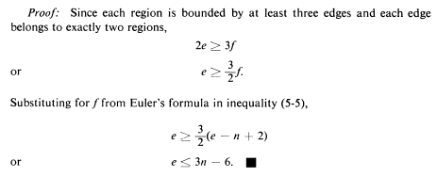
Planar Graph
Where, Euler’s formula
f = e – n + 2

Slide 3
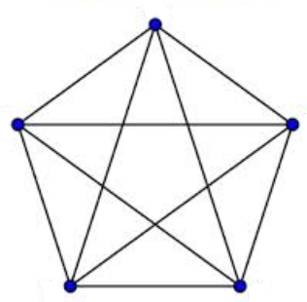
Planar Graph
If the inequality is true, the graph is planar, else it is non-planar
In case of K5, the no. of vertices, n = 5, edge, e = 10
The inequality is:
Therefore, e <= 15 – 6 <= 9 but e = 10.
Hence, 10 <= 9
So the inequality is wrong and the graph is non-planar.

Slide 4
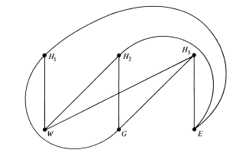
Planar Graph
What happens for K3,3 graph?
In case of K3,3, the no. of vertices, n = 6, edge, e = 9
The inequality is: e <= 3n - 6
Therefore, e <= 18 – 6 <= 12 but e = 9.
Hence 9 <= 12
So the inequality is true and the graph must be planar but in reality the K3,3 graph is non-planar.
How is it possible??

Slide 5
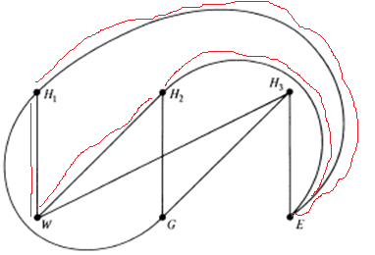
Planar Graph
What happens for K3,3 graph?
In case of K3,3, atleast 4 edges are required to bound any region.
Hence, the inequality becomes: 2e >= 4f
i.e. e >= 2f
i.e. e >= 2(e – n + 2)
i.e. e <= 2n - 4
Therefore, for n = 6 and e = 9 we have,
e <= 12 – 4 <= 8 but e = 9.
Hence 9 <= 8
So the inequality is false and the graph is non-planar.

Slide 6
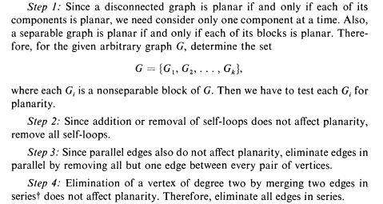
Detection of Planarity

Slide 7

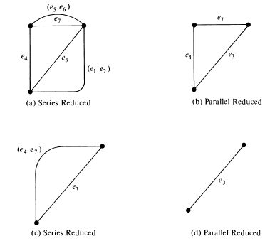
Contd..

Slide 8
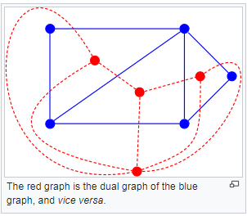
Dual Graph
The dual graph of a plane graph G is a graph that has a vertex for each face of G. The dual graph has an edge whenever two faces of G are separated from each other by an edge, and a self-loop when the same face appears on both sides of an edge.

Slide 9
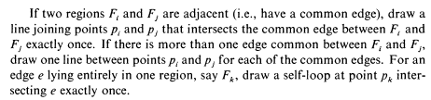
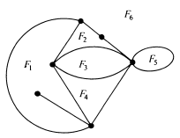
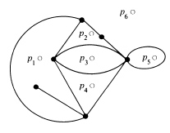
Contd..

Slide 10
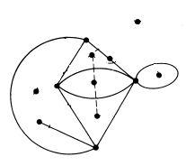
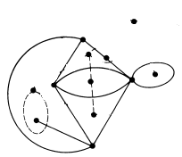
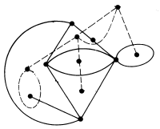
Contd..

Slide 11
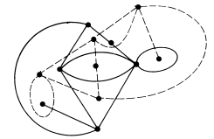
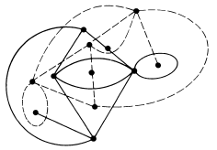
Contd..

Slide 12
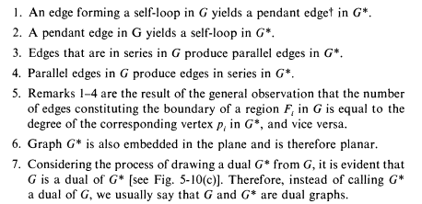
Dual Graph properties

Slide 13
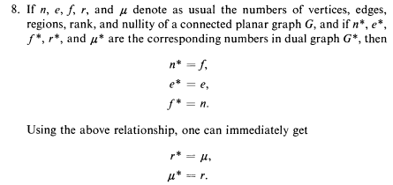
Dual Graph properties

Slide 14
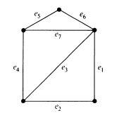
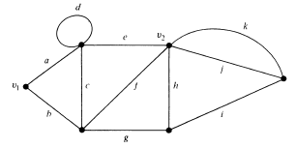
Question
Find the dual graph of the following graphs and verify its correctness
G1
G2

